Slide 1
Efficient Age Prediction for Targeted Advertising Using Knowledge Distillation

Slide 2
01
Introduction & Motivation
02
Related Work
Dataset
Baseline Model
Evaluation Index
Outline
03
Working Flow
04
Results
05
Demo & Conclusion

Slide 3
Introduction
We introduces a novel approach using lightweight deep learning models for real-time facial analysis in spaces such as malls and waiting areas.
This method aims to enhance the precision of ad targeting and audience engagement by accurately assessing age thereby enriching the consumer experience with more engaging and tailored messages.
Keywords：
Facial Recognition, Age Prediction, Real-Time Analysis, Dynamic Content Customization
Vestibulum ante ipsum primis inVestibulum ante ipsum primis in faucibus orciestibulum ante ipsum primis in faucibus orcaucibus orci

Slide 4
Motivation
Increased Ad Efficiency: Targeting inefficiency in broad-based and resource wastage advertising through real-time, relevant ad personalization using facial recognition
Privacy Consideration: Balancing personalized advertising with stringent respect for user privacy in response to growing data protection concerns.
To address this, we propose the use of lightweight facial recognition model for real-time, personalized advertisement adjustments, respecting user privacy.
Vestibulum ante ipsum primis inVestibulum ante ipsum primis in faucibus orciestibulum ante ipsum primis in faucibus orcaucibus orci

Slide 5
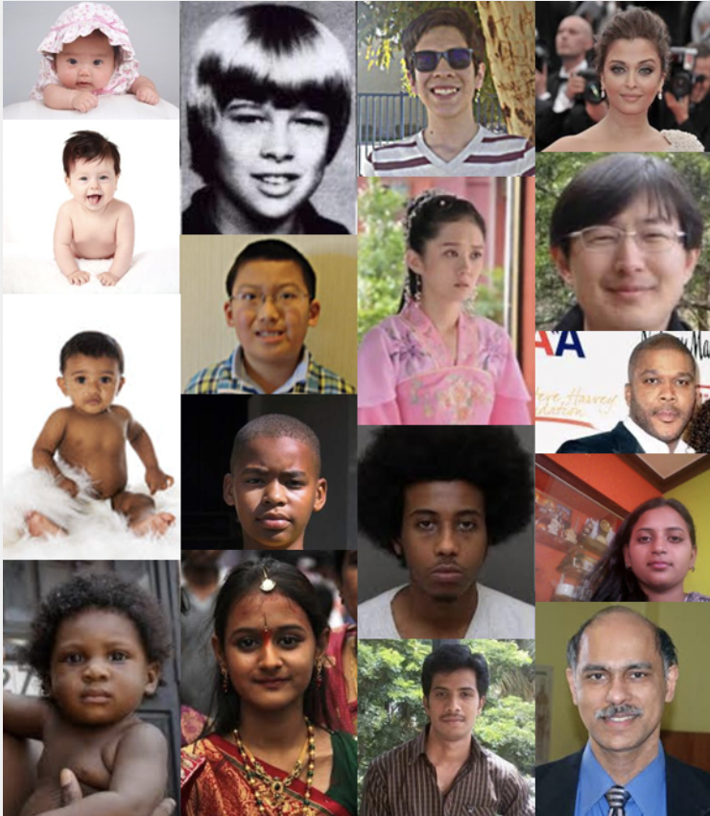
Dataset_UTKFace
UTKFace dataset’s age range from 0 to 116 years old).
The dataset consists of over 20,000 face images with annotations of age, gender, and ethnicity.
The images cover large variation in pose, facial expression, illumination, resolution, etc.

Slide 6
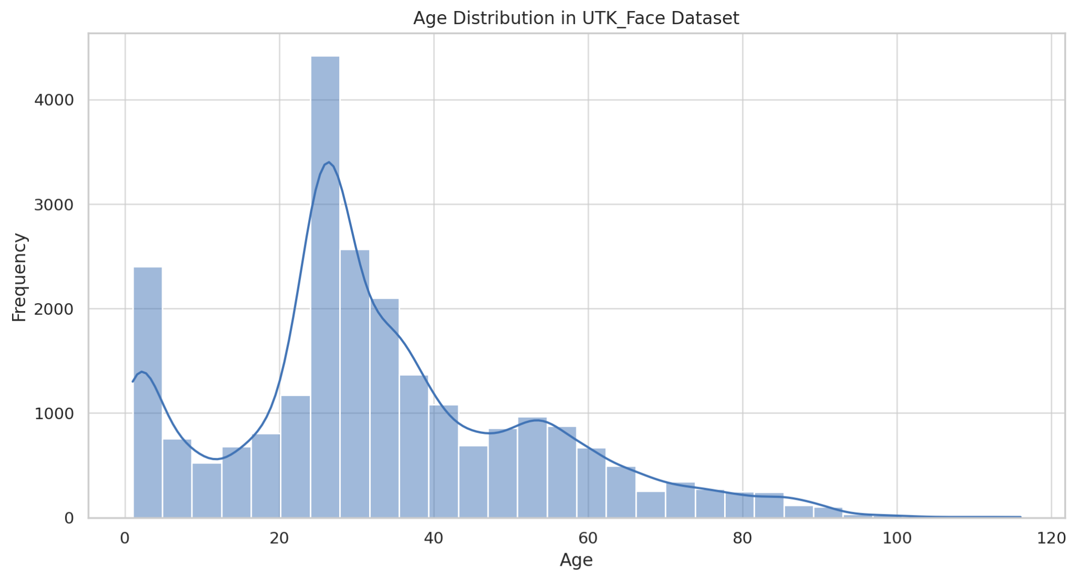
Dataset_UTKFace
The UTKFace dataset lacks diversity in age, and backgrounds, potentially causing biases and hindering performance with underrepresented groups.
Poor lighting, pose, and resolution in some dataset images can introduce noise, degrading model performance.

Slide 7
Baseline models
We choose ResNet152 as teacher model for our project on facial recognition with age estimation due to its widespread use and proven performance.
We aim to provide a robust foundation for comparison when implementing knowledge distillation to let the teacher model to teach the student model.
The goal is to enhance the efficiency of these models by reducing the number of parameters while maintaining or even improving their performance, ultimately making them more practical for real-world applications.

Slide 8
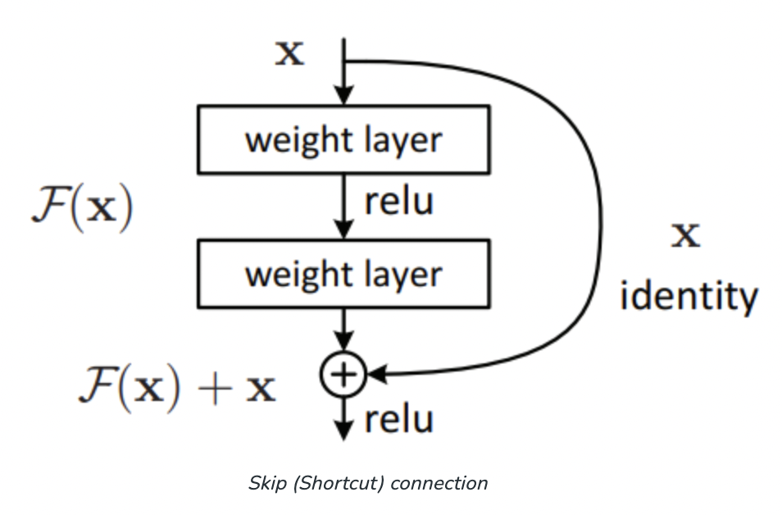
Resnet 50
ResNet50 is noted for its ability to train exceptionally deep neural networks, whch introduces residual learning through skip connections, addressing challenges like vanishing gradients.
With 50 layers and a combination of Conv layers, BN, and ReLU activation functions, ResNet50 excels in image classification tasks.
Vestibulum ante ipsum primis inVestibulum ante ipsum primis in faucibus orciestibulum ante ipsum primis in faucibus orcaucibus orci

Slide 9
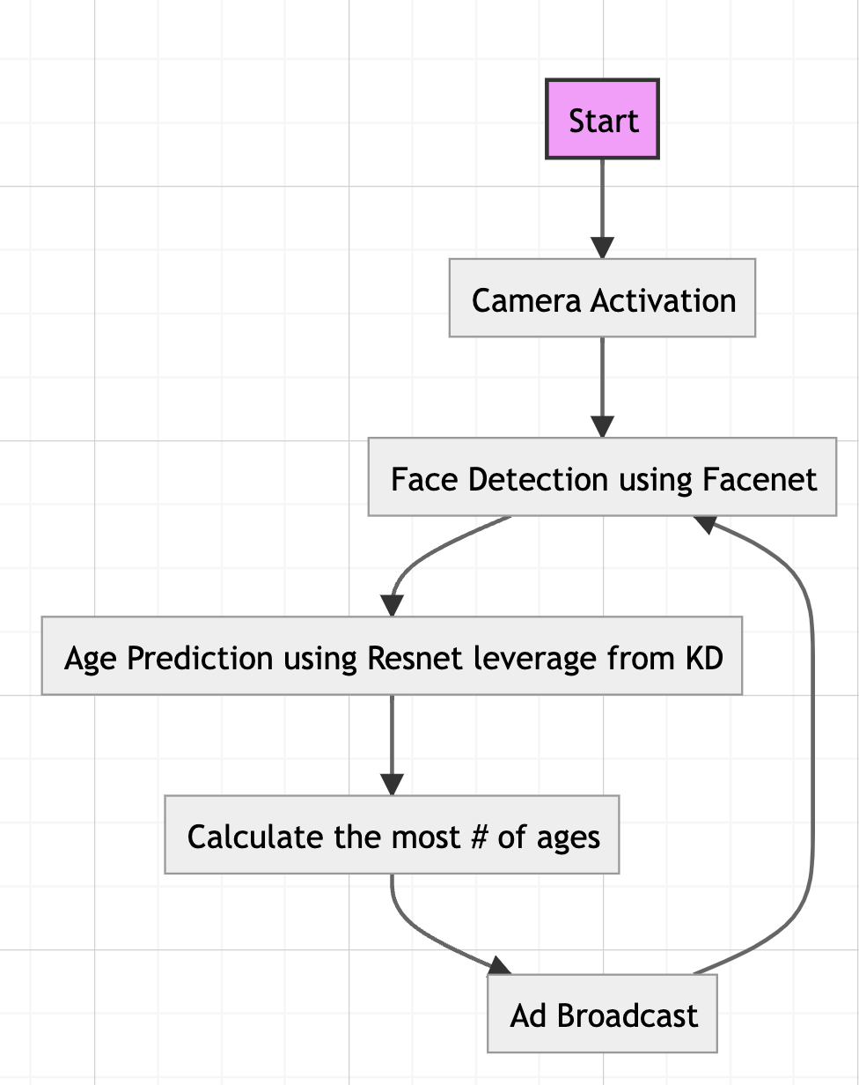
Working Flow

Slide 10

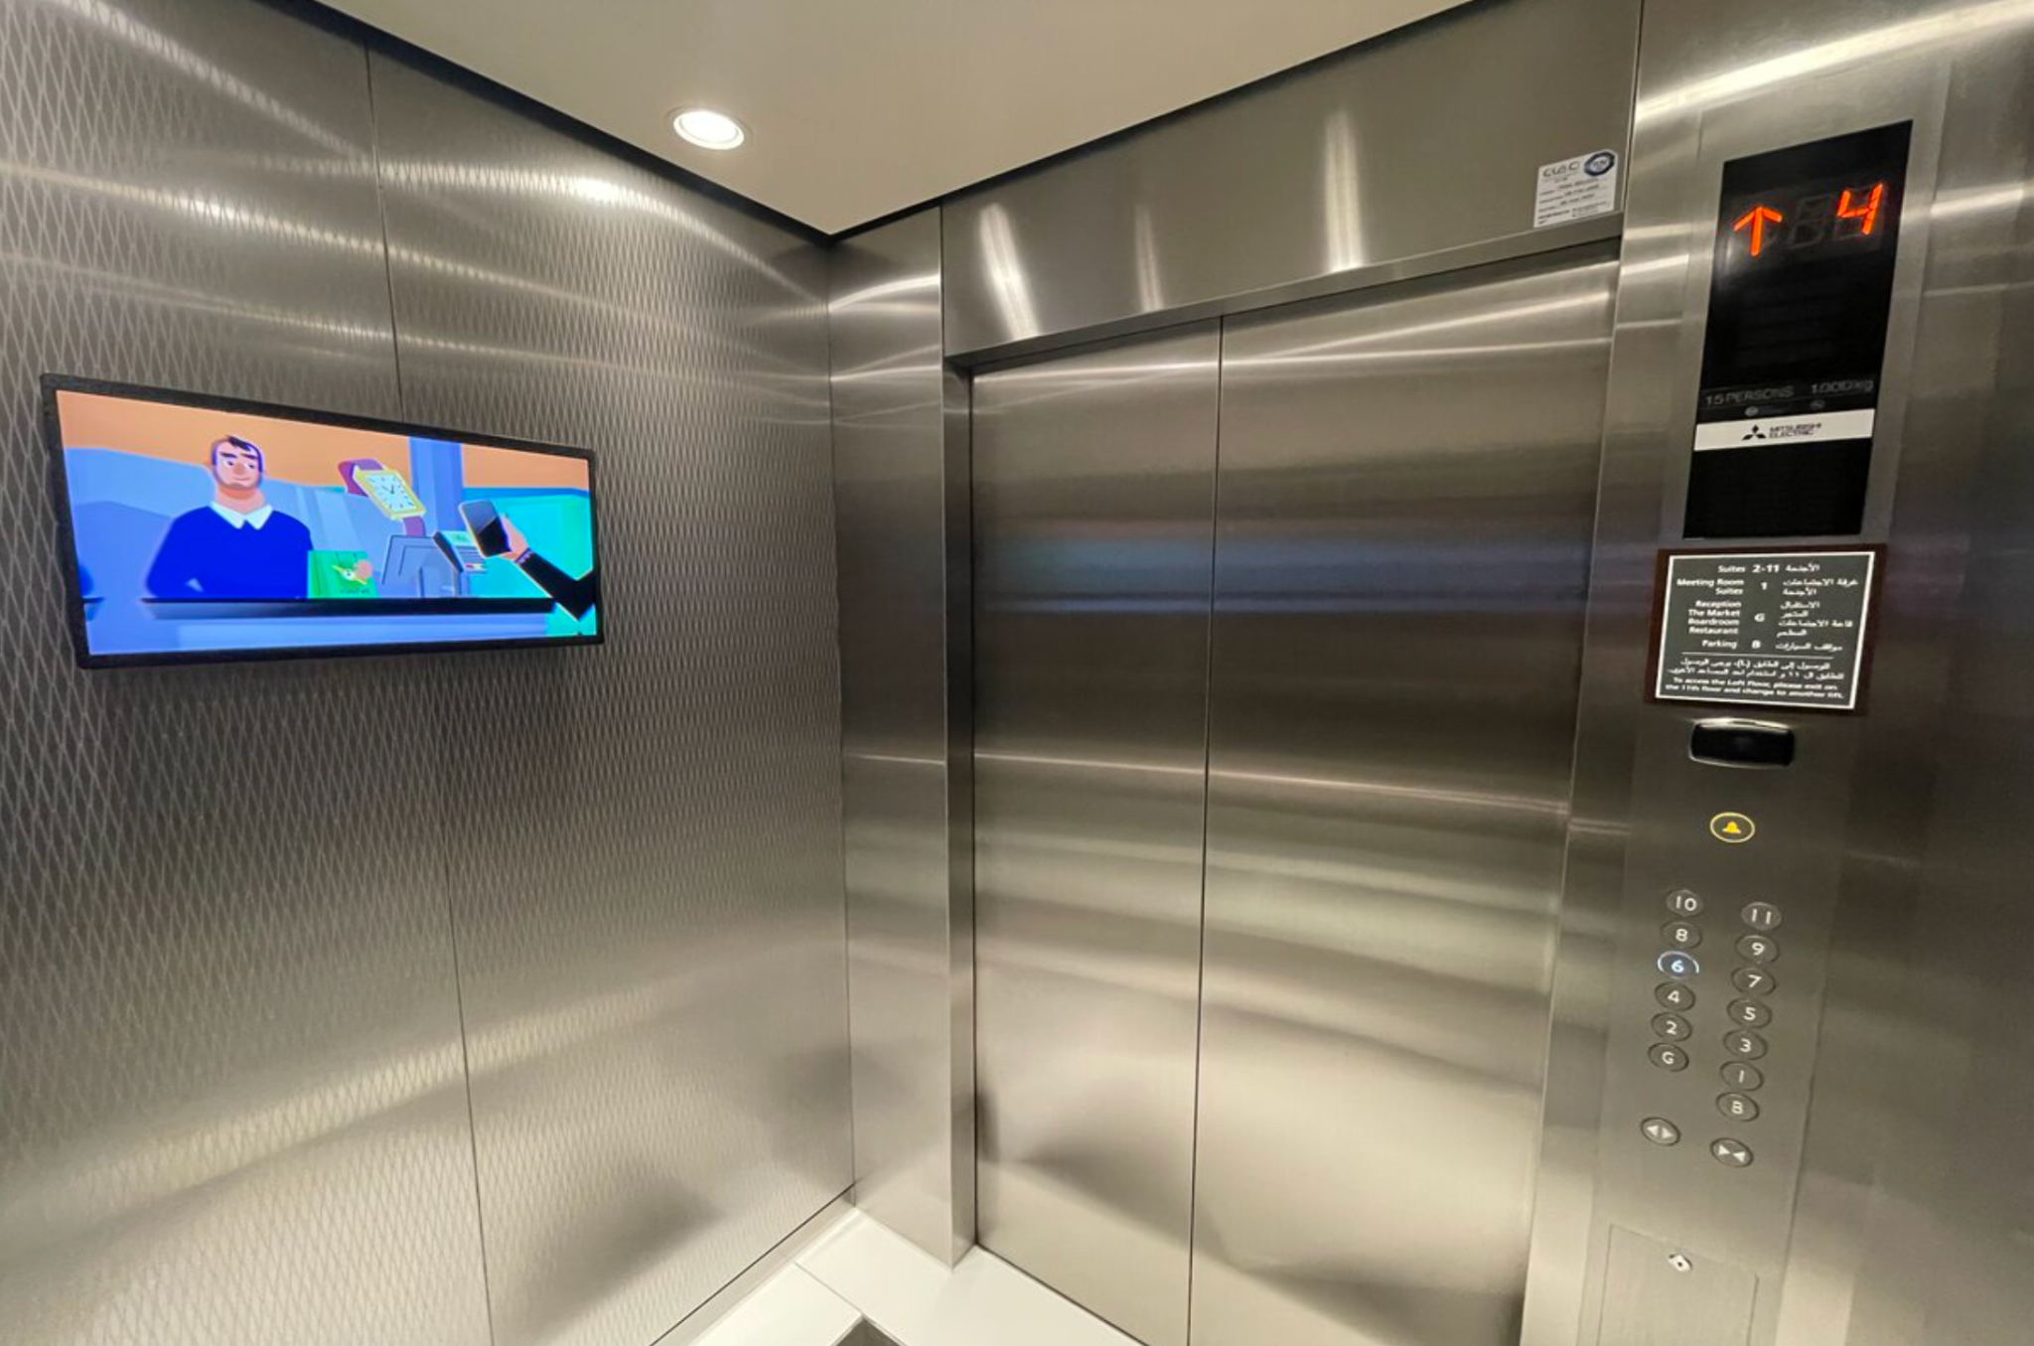
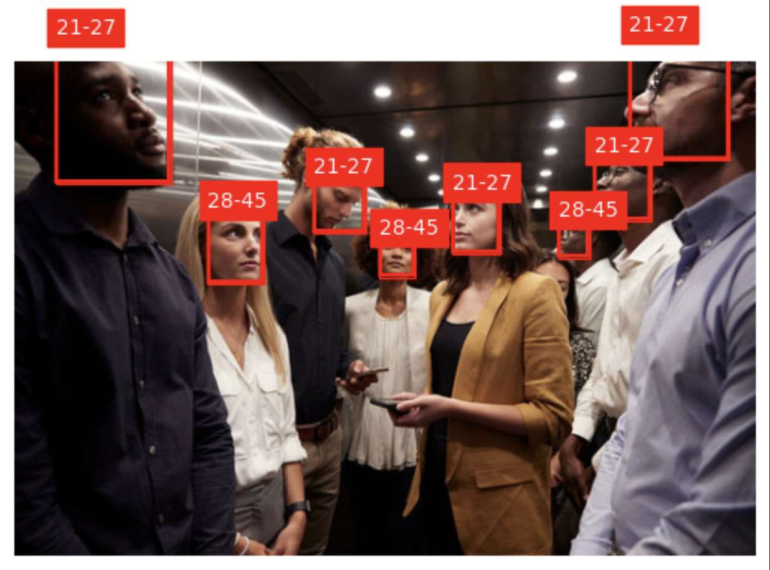
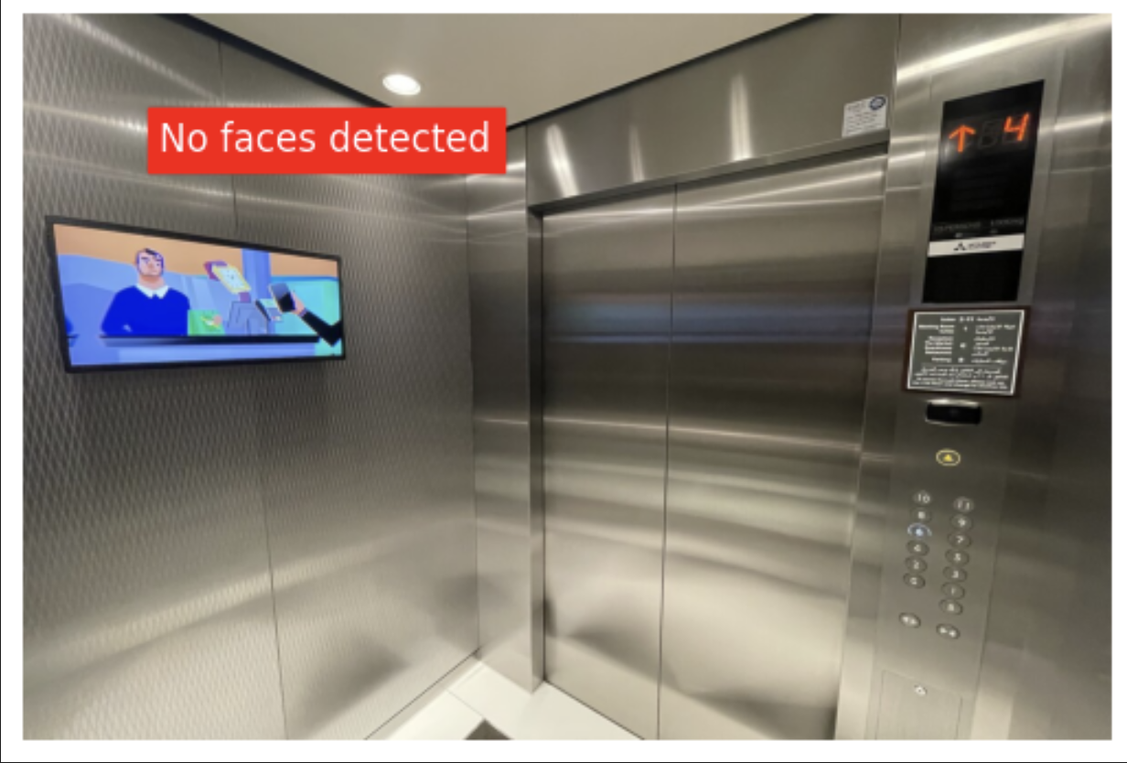
Working Flow
Input
Output

Slide 11
Evaluating Model Performance
Accuracy：
For gender identification：A binary approach can be employed, distinguishing between male and female categories.
For age detection：Dividing age into several categories
{'1-2', '3-9', '10-20', '21-27', '28-45', '46-65', '66-116'}
We used “Accuracy” to estimate our model performance.
Vestibulum ante ipsum primis inVestibulum ante ipsum primis in faucibus orciestibulum ante ipsum primis in faucibus orcaucibus orci

Slide 12
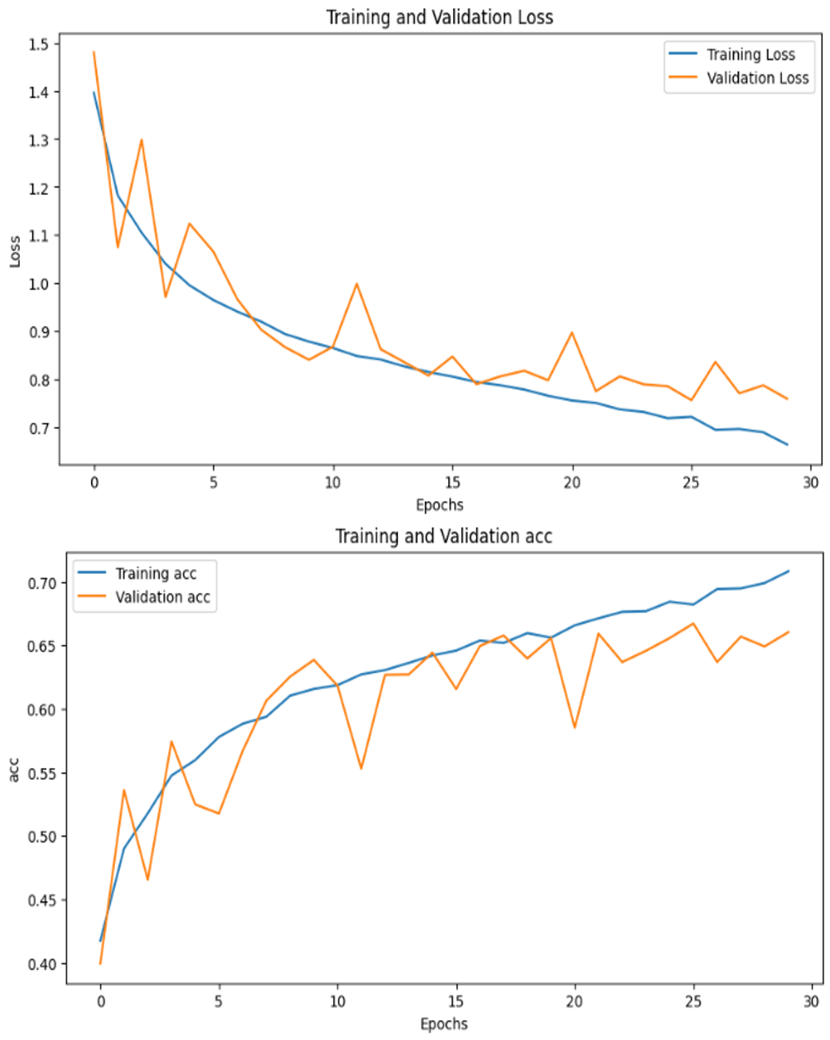
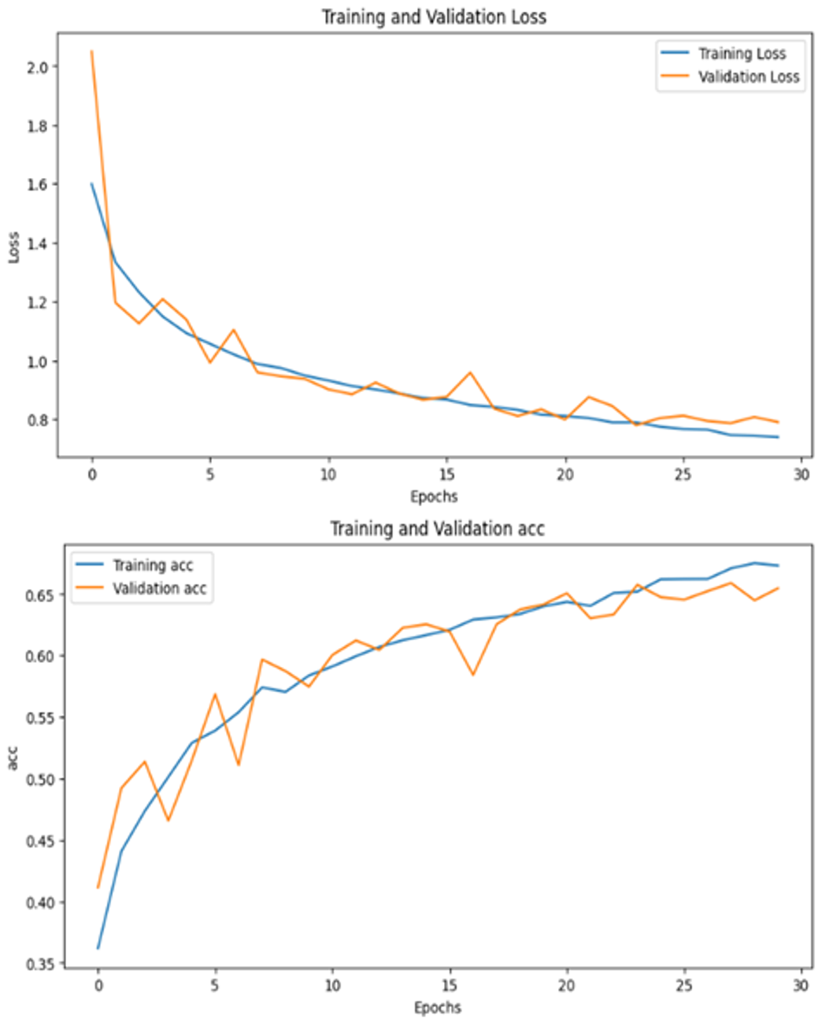
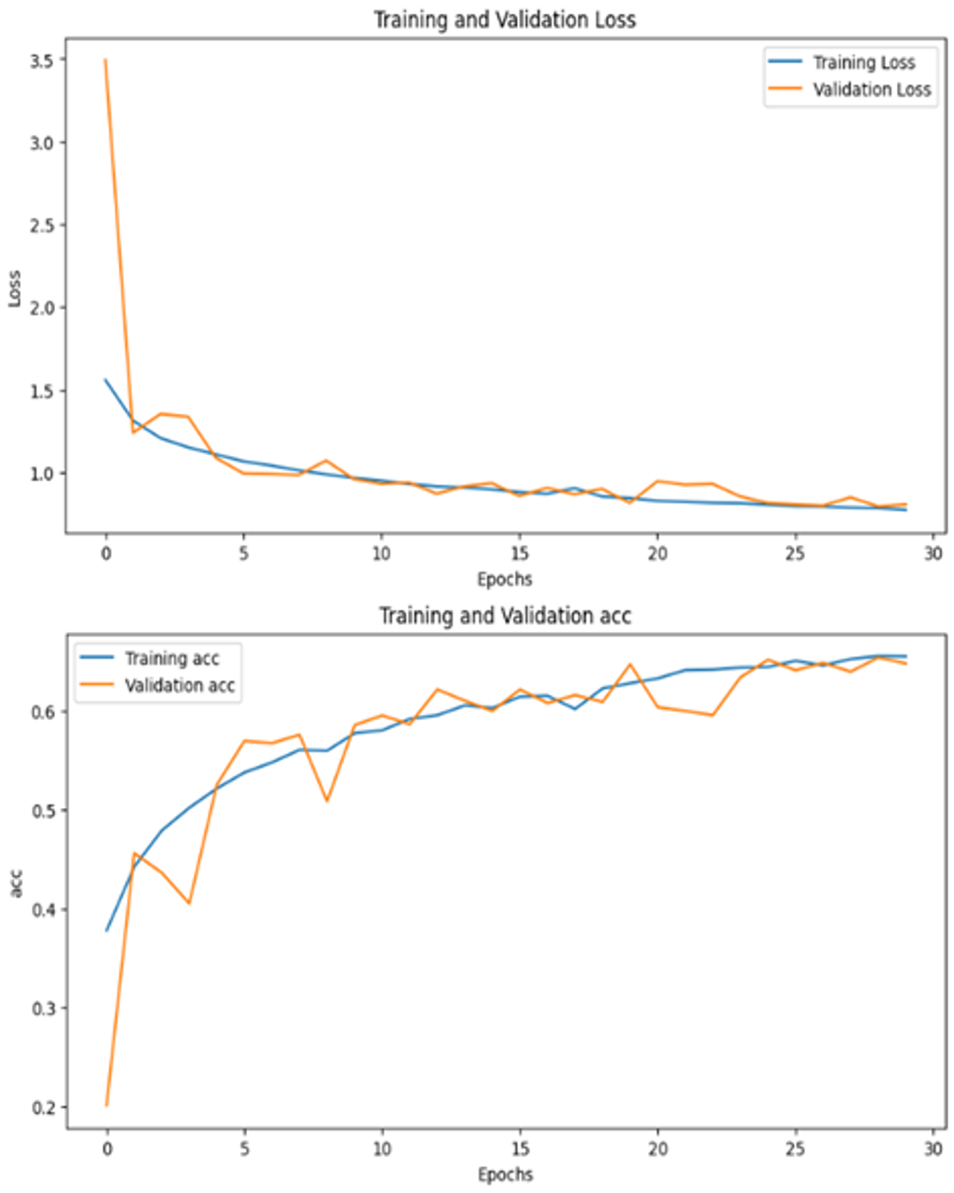
Results(UTKFace)
ResNet18 ResNet50 ResNet34
Vestibulum ante ipsum primis inVestibulum ante ipsum primis in faucibus orciestibulum ante ipsum primis in faucibus orcaucibus orci

Slide 13
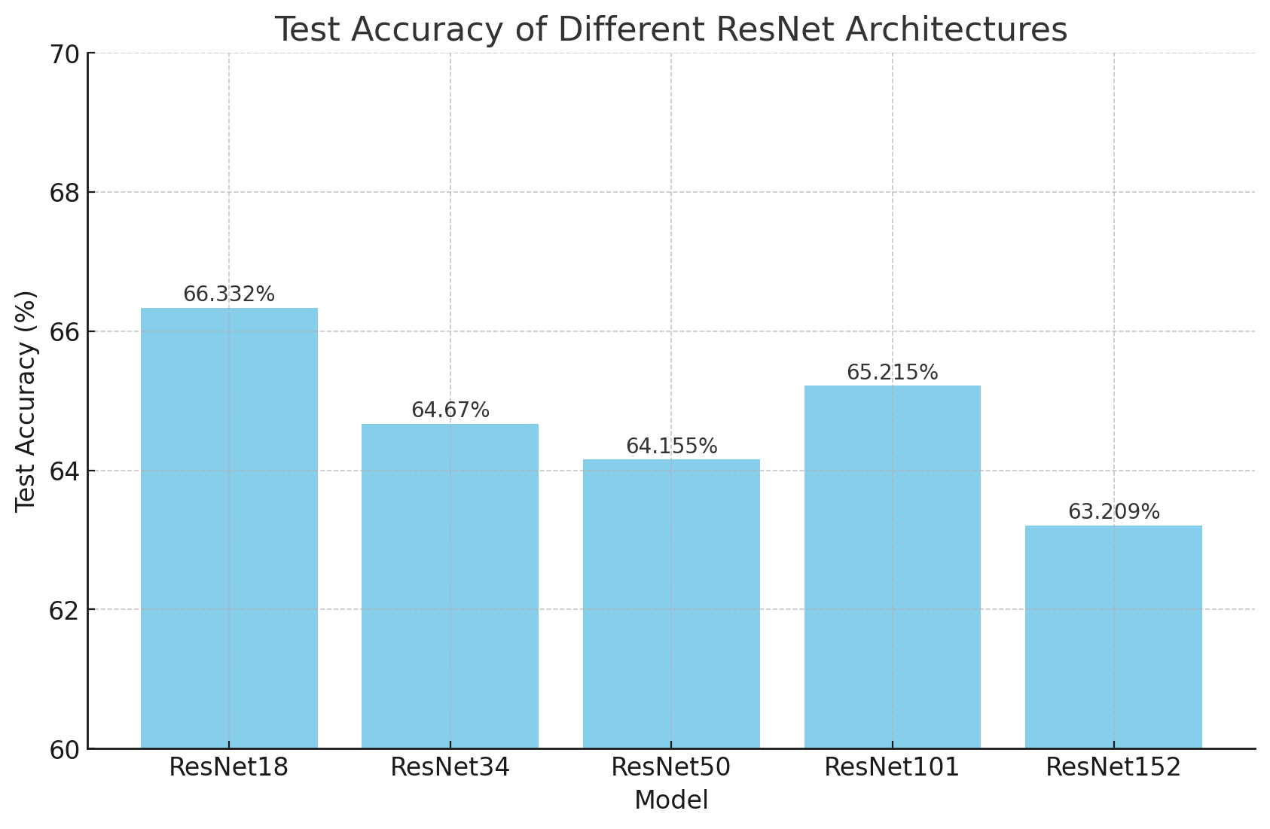
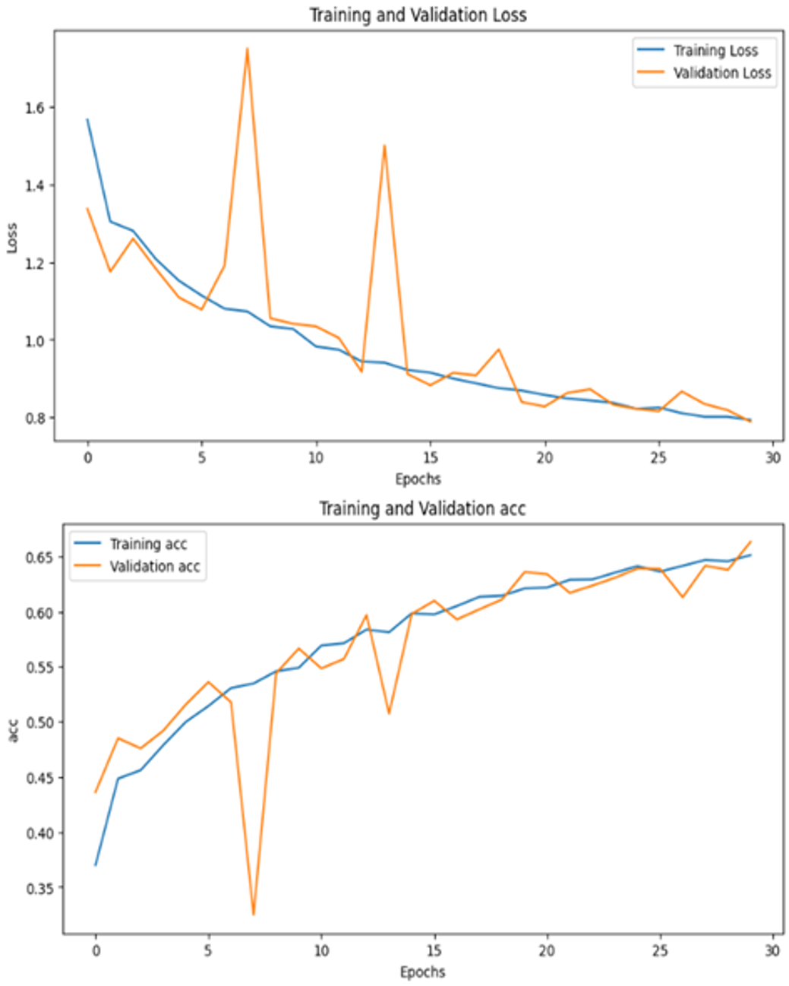
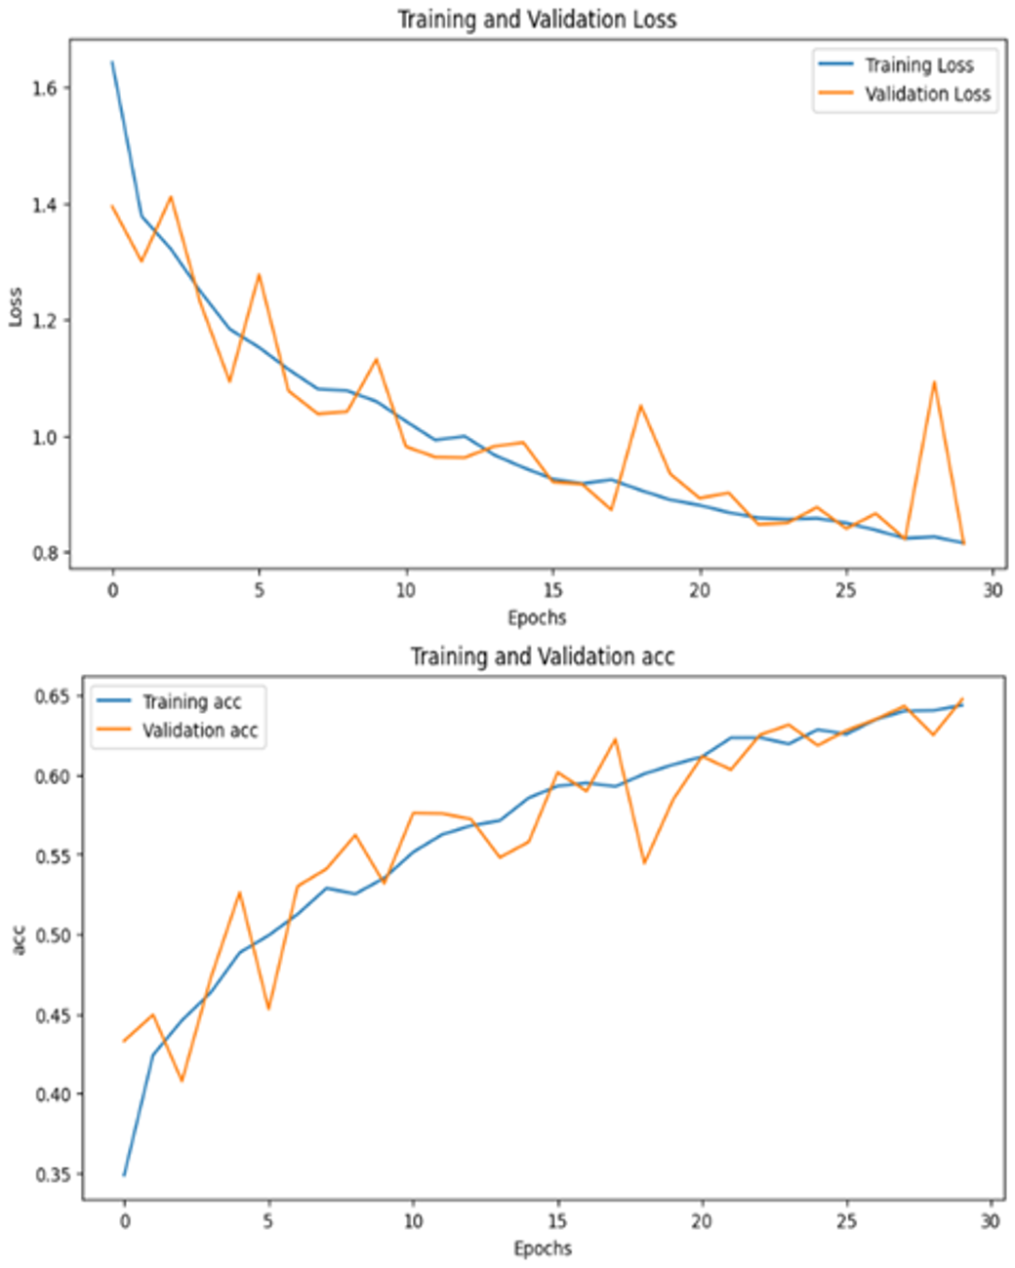
Results(UTKFace)
ResNet101 ResNet152
Vestibulum ante ipsum primis inVestibulum ante ipsum primis in faucibus orciestibulum ante ipsum primis in faucibus orcaucibus orci

Slide 14
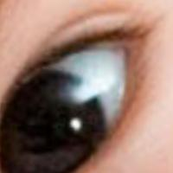

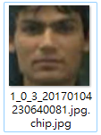
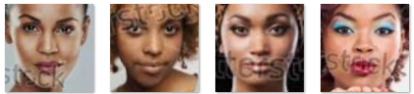
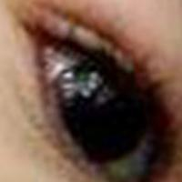

Trouble Shooting
Initially, we trained the ResNet model on the UTKFace dataset but encountered challenges with low accuracy (60%).
we identified non-facial images and mismatches between age labels and actual faces.
After several adjustments to our age categorization strategy, by simplifying it into four groups: children(0-14),younth(15-22) adults(23-40), and the elderly(41-116), the accuracy improved to about 80%.

Slide 15
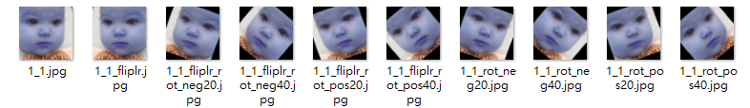
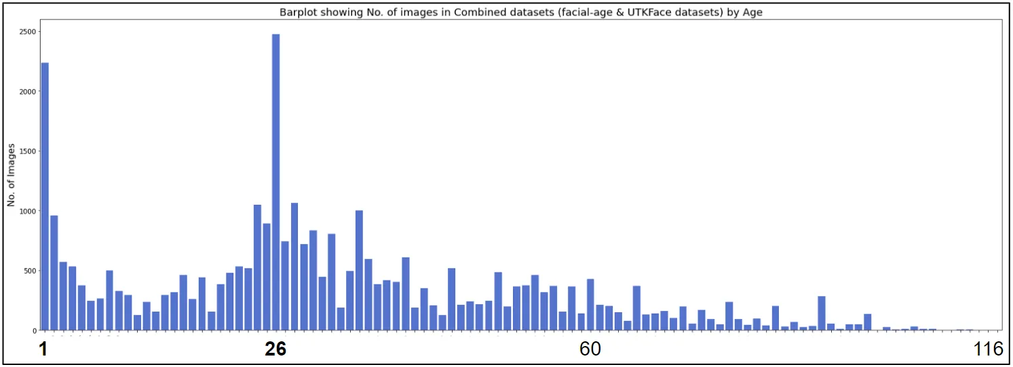
Data Augumentation
The original UTKFace dataset comprised only 23,000 images with an uneven distribution across age groups.
Therefore, we merged the UTKFace and Facial Age datasets, amassing approximately 34,000 images. By applying data augmentation techniques such as horizontal flipping and rotating left and right, we expanded the training dataset(70%) to 234,000 images.
Vestibulum ante ipsum primis inVestibulum ante ipsum primis in faucibus orciestibulum ante ipsum primis in faucibus orcaucibus orci
(Data set)

Slide 16
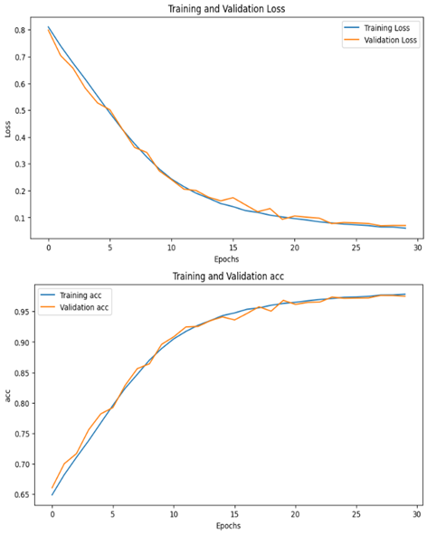
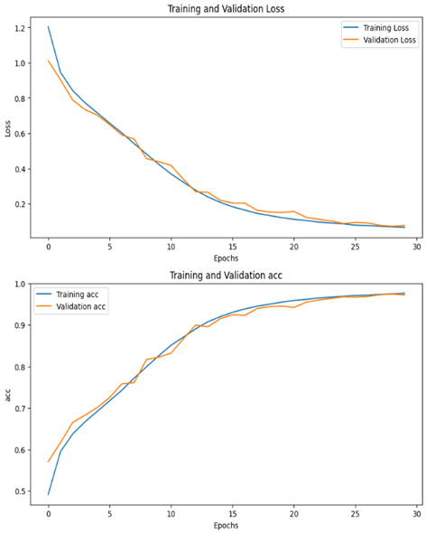
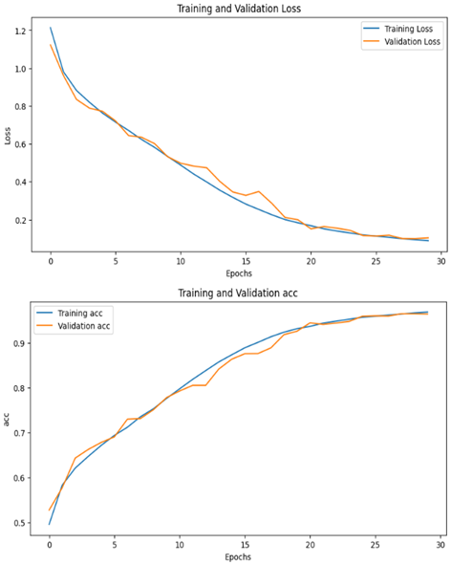
Results(UTKFace+Facial Age)
we refined our approach from four to seven age groups: 1-2, 3-9, 10-20, 21-27, 28-45, 46-65, and 66-116.
ResNet18 ResNet50 ResNet34
Vestibulum ante ipsum primis inVestibulum ante ipsum primis in faucibus orciestibulum ante ipsum primis in faucibus orcaucibus orci

Slide 17
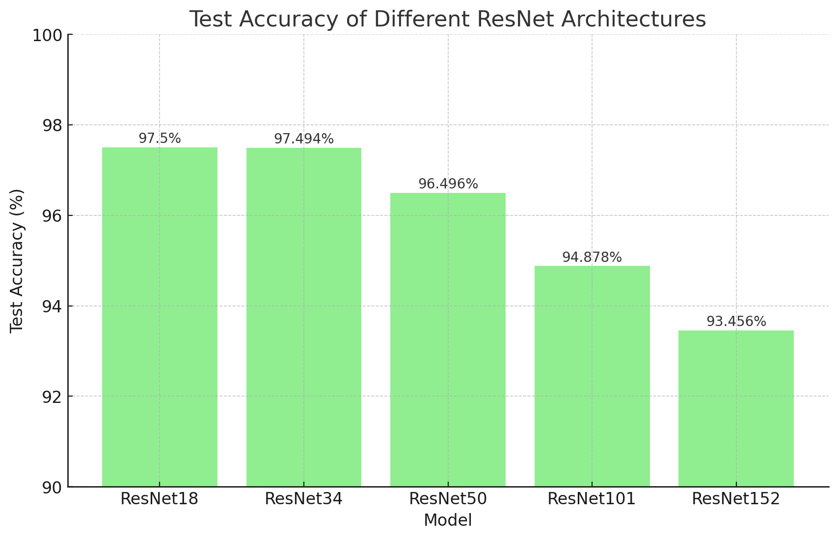
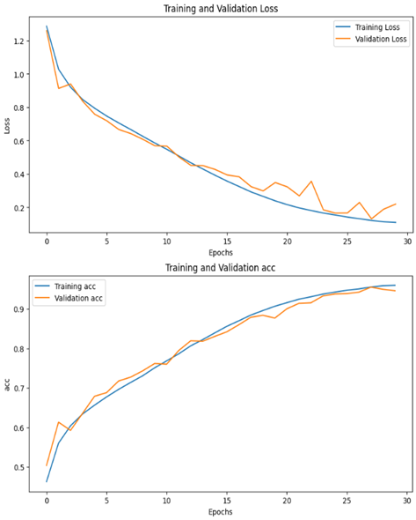
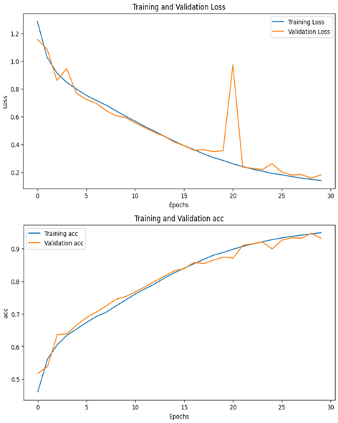
Results(UTKFace+Facial Age)
ResNet101 ResNet152
Vestibulum ante ipsum primis inVestibulum ante ipsum primis in faucibus orciestibulum ante ipsum primis in faucibus orcaucibus orci

Slide 18
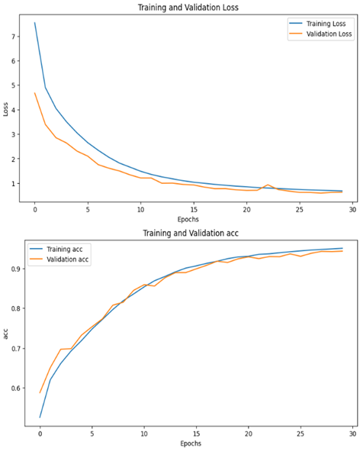
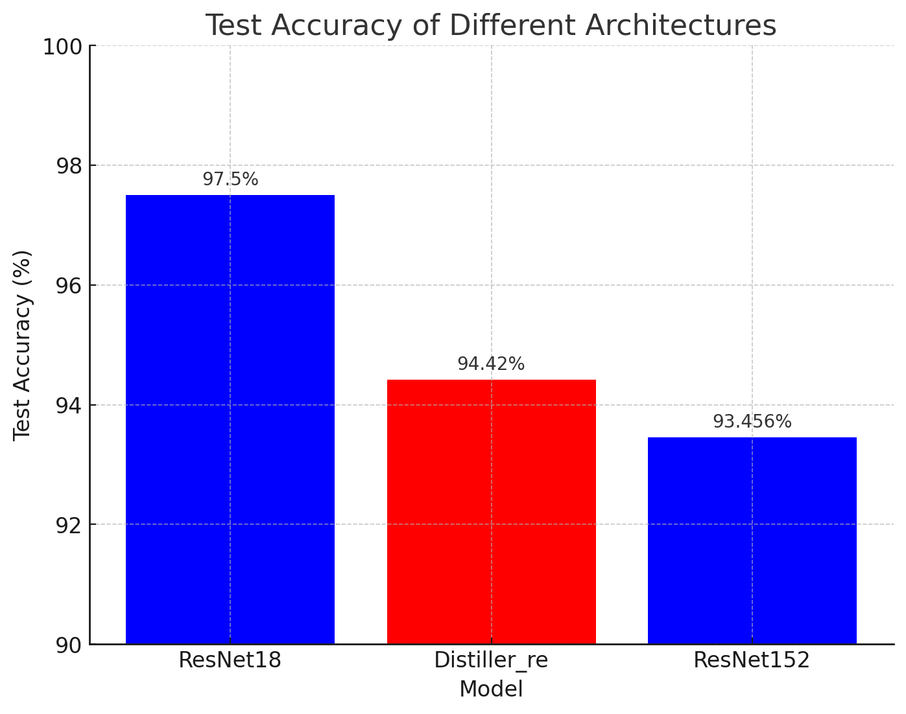
Efficient Design_KD
Teacher：ResNet152
Student：ResNet18
Method：Response-based distillation
Vestibulum ante ipsum primis inVestibulum ante ipsum primis in faucibus orciestibulum ante ipsum primis in faucibus orcaucibus orci

Slide 19
Comparison
 | param mem | flops | Accuracy
ResNet18 (from scratch) | 45 MB | 2 GFLOPs | 97.50%
ResNet18 (KD) | 45 MB | 2 GFLOPs | 94.42%
ResNet34 | 83 MB | 4 GFLOPs | 97.49%
ResNet50 | 98 MB | 4 GFLOPs | 96.49%
ResNet101 | 170 MB | 8 GFLOPs | 94.87%
ResNet152 | 230 MB | 11 GFLOPs | 93.45%
Vestibulum ante ipsum primis inVestibulum ante ipsum primis in faucibus orciestibulum ante ipsum primis in faucibus orcaucibus orci

Slide 20
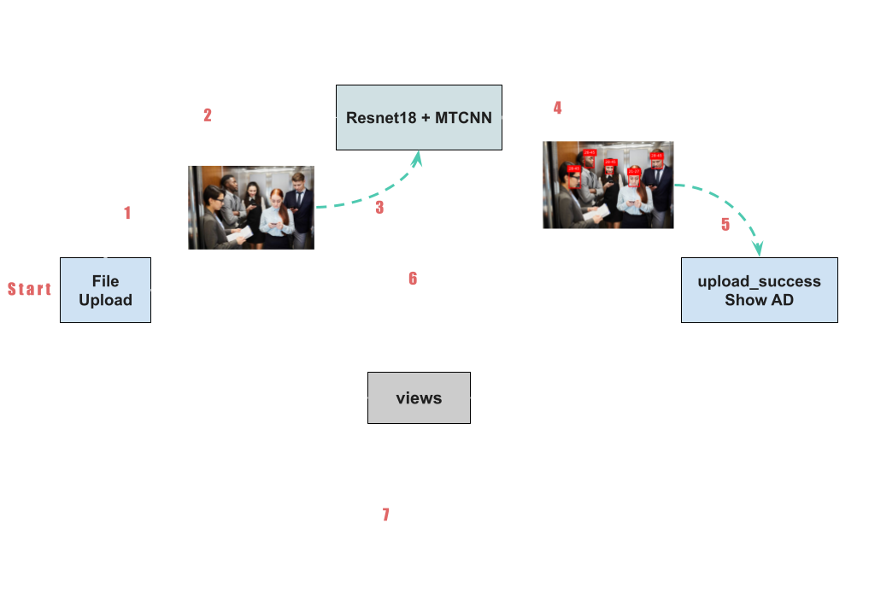
Demo (Web)
Web Framework：Django
Vestibulum ante ipsum primis inVestibulum ante ipsum primis in faucibus orciestibulum ante ipsum primis in faucibus orcaucibus orci
Notes:
在成果展示的部分，我們使用了Django，他是一個python網頁框架，這邊是我們大概的實現方法，從左邊start開始，使用者上傳照片後，會存成一個叫input的檔案，接著會觸發我們的model去抓取這張input，再來模型輸出的年齡判別會存成叫做output的檔案，跳轉後的頁面會再去抓去這張output同時也輸出適合的廣告。

Slide 21
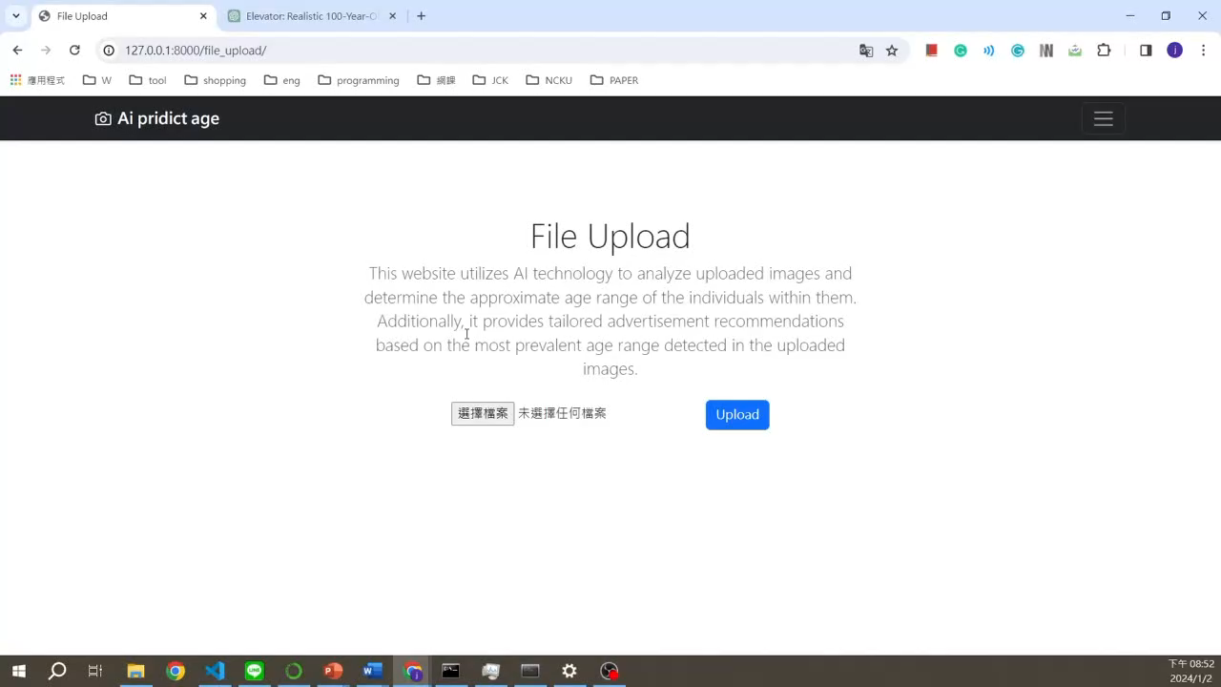
Demo Video
Vestibulum ante ipsum primis inVestibulum ante ipsum primis in faucibus orciestibulum ante ipsum primis in faucibus orcaucibus orci

Slide 22
Conclusion
Our project targets elevator passengers with customized ads based on their age group.
We use Knowledge Distillation (KD) for real-time, lightweight model processing.
With Multi-task Cascaded Convolutional Networks (MTCNN) for face detection, we identify the most common age group in the elevator to tailor ads.
We've created a Django-based webpage to easily present our findings.
Vestibulum ante ipsum primis inVestibulum ante ipsum primis in faucibus orciestibulum ante ipsum primis in faucibus orcaucibus orci
Notes:
1.這個專題的出發點是針對電梯中不同年齡層的人來推送客製化廣告
2.為了達到real time的效果，我們使用了KD來做模型輕量化
3.考慮到電梯裡不只有單獨一人的場景，我們加入了人臉偵測MTCNN來判斷當時哪個年齡層的人最多，然後決定推送哪種廣告
4.最後，為了讓大家更容易清楚我們所做的成果，我們做了一個django網頁來呈現

